Slide 1
Sun Microsystems
Acquired by Oracle??
PRESENTED BY -
ALVINA BOHORA
KHUSHBOO MUNDADA
KEYA KEYA
Instructor: Prof. Francis X. Apicella
Class: Financial Analysis for Tech Managers
Date - 12/13/2022
Notes:
Key

Slide 2
Merger & Acquisition
Merger: A merger is the complete absorption of one firm by another. The acquiring firm retains its name and its identity, and it acquires all the assets and liabilities of the acquired firm. After a merger, the acquired firm ceases to exist as a separate business entity.
Acquisition: An acquisition is when one company purchases most or all of another company's shares to gain control of that company. Purchasing more than 50% of a target firm stock and other assets allows the acquirer to make decisions about the newly acquired assets without the approval of the company’s other shareholders.

Slide 3
Types of Acquisition
Horizontal acquisition: This is an acquisition of a firm in the same industry as the bidder.
Vertical acquisition: When a company acquires another company that is a part of the same industry but at a different production level
Conglomerate acquisition: When the bidder and the target firm are in unrelated lines of business, the merger is called a conglomerate acquisition.

Slide 4
About the case
Sun Microsystem
Hardware and Server’s Producer
Closing day share price - $6.69
Oracle
Software company, database
Bid Price - $9.50 (More than 40% Premium)
$7.38 Billion to acquire Sun

Slide 5
Questions
1. Is Sun Microsystems a good “Strategic” fit for Oracle? Why or why not?
2. Prepare a Discounted Cash Flow Analysis to Value Sun on a “stand alone’ basis
A. What rate of return should Oracle require on the acquisition of Sun?
B. What base case cash flows do you forecast?
C. What is your estimate of Terminal Value?
D. What is the Enterprise Value of Sun? What is the Equity Value?
3. Conduct a “Multiples” analysis to value Sun. What economic fundamentals are reflected in the multiples?
4. Use the integration costs and expected synergy amounts to complete a SEPARATE analysis valuing these items ONLY!
5. If a competing bidder appears, how a high a price should Oracle be willing to offer?

Slide 6
Is it a Strategic fit?
Certain businesses gain an advantage by creating strategic alliances with firms in other industries producing complementary products, especially in high-tech industries.
Some acquisitions promise a strategic advantage. This is an opportunity to take advantage of the competitive environment if certain things occur or, more generally, to enhance management flexibility with regard to the company’s future operations. In this latter sense, a strategic benefit is more like an option than a standard investment opportunity

Slide 7
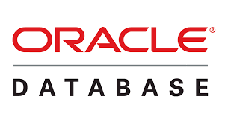
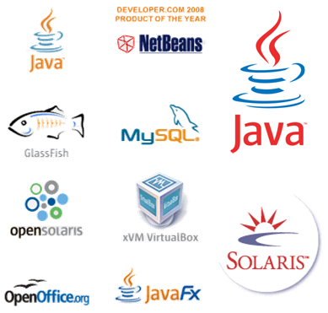


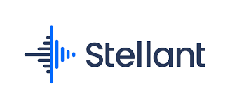

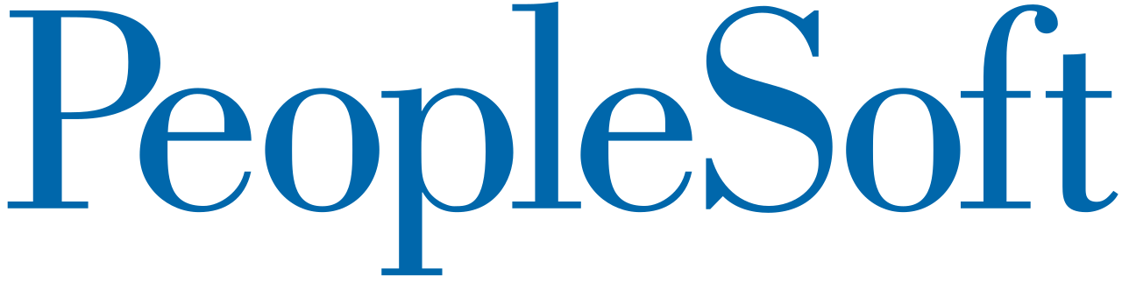
Product offering
Sun Oracle

Slide 8
Strategic fit?
Absolutely yes, with Oracle’s dominant position in the software space and Sun’s expertise in the hardware and network area make them great fit for each other.
Oracle’s database and Sun’s servers had kept both the firms in the forefront in sales for a very long time.
With this merger a united front against Microsoft, exploiting Solaris and Java as foundations for business software.
The biggest source of revenue for is the potential new products that could be developed at the intersection of Sun and Oracles technologies. Most of Oracles software were built using Java and ran on Solaris operating system.

Slide 9
Discounted Cash Flow Analysis
DCF

Slide 10
What is DCF Analysis?
The purpose of DCF analysis is to estimate the money an investor would receive from an investment, adjusted for the time value of money.
The time value of money assumes that a dollar that you have today is worth more than a dollar that you receive tomorrow because it can be invested. As such, a DCF analysis is useful in any situation where a person is paying money in the present with expectations of receiving more money in the future.

Slide 11
WACC: Calculating Re
For calculating WACC we first have to calculate Re
Re = Rf + Beta (Rm-Rf)
Rf= Risk free rate given which is 2.82% which is the value of 10 year treasury bond rate from Exhibit 10
Beta= 1.73 from Exhibit 9
EMRP = 6% from the hint provided by Prof.
Emrp= Rm-Rf
Thus,
Re= 2.82% + 1.73 * 6% = 13.2%
Re= 13.2%

Slide 12
WACC Calculation
Rd = 11.42% based on credit rating
Tax rate = 35%
Debt= 1257 (Book value) from Exhibit 9
Equity= Stock price* shares outstanding ( From Exhibit 9 Market value)
= 6.69 * 739 = 4944
Thus Value= Equity + Debt = 1257 + 4944= 6201

Slide 13
WACC: Cont
WACC = Re (E/V) + {Rd (D/V) (1-t)}
where E/V is the proportion of equity and D/V is the proportion of Debt to value
Thus WACC = 13.2%(4944/6201)+ ( 11.42% (1257/6201) * (1-35%)
=12.03%

Slide 14
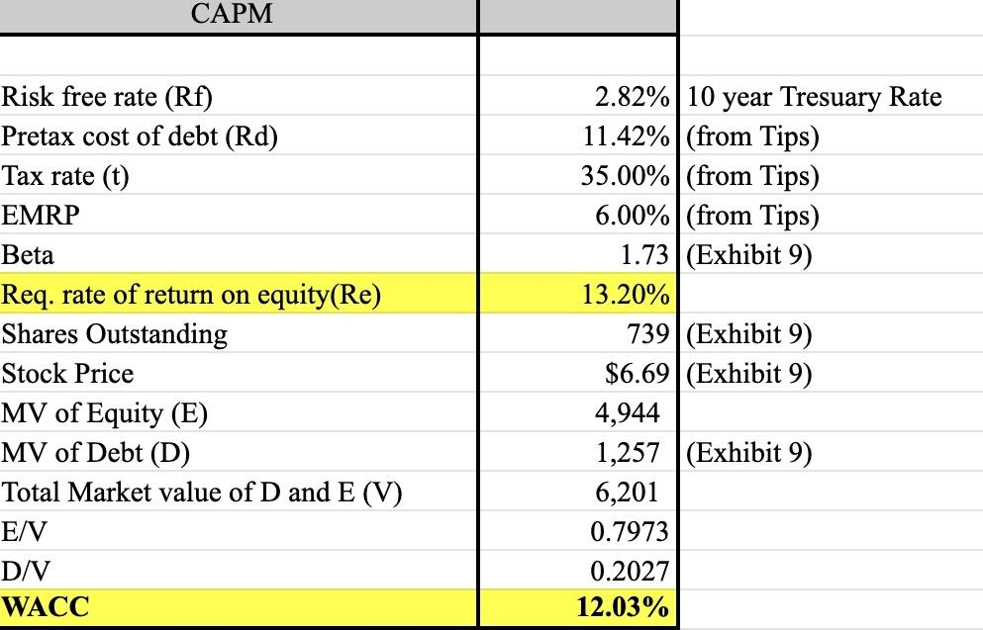
WACC:

Slide 15
Multiple Analysis
And the Economic fundamentals Reflected

Slide 16
What is Multiples Analysis?
The multiples analysis is a valuation technique that utilizes different financial metrics from comparable companies to value a target company. Thus, the assumption is that the relative value of certain financial ratios can be used to rank or value a company within a similar group.
In our analysis, we are comparing financial datas of peer hardware companies of Sun Microsystems.

Slide 17
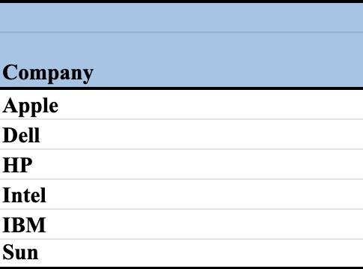
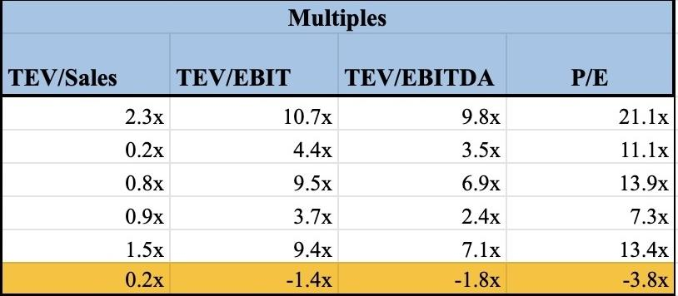
Multiple Analysis :
The EBIT rate is negative which implies that Sun Microsystems are making losses.
However, the only bright side is a positive Sales rate indicating that the company is still making sales of 0.2 per share.

Slide 18
Synergy Value

Slide 19
Synergy Value
This is an attempt to put a present valuation on incremental cash flows that will result from combining firms; should be discounted at the most appropriate rate – which could be based on cost of capital of one firm or the other – e.g., if firm A is acquiring firm B – then appropriate rate could be firm B’s since presumably it would represent the riskiness of firm B’s assets

Slide 20
The Integration expense of $1.1 billion in incorporated in the stand alone analysis of Sun Microsystems.
In addition, Oracle anticipates initial loss of $45 million due to loss of customers/delayed purchases upon merger.
Cost cutting through layoffs by 20% to 25%, slashing of SG&A expenses by 22% to 32% and addition of a new product has potential are few future decisions
This would boost operating profit upto $900 million each year.
The calculations are based on assumptions of this max value.(Refer Excel)

Slide 21
Competitor bidder situation
With a case of competing bidder the maximum limit that Oracle can bid is $ 20.53 ( See Excel)
Oracle cannot offer a price beyond this to acquire Sun Microsystems.

Slide 22
Thank You

